Slide 1
Forgiveness…
God and You,
You and You,
You and Others…

Slide 2
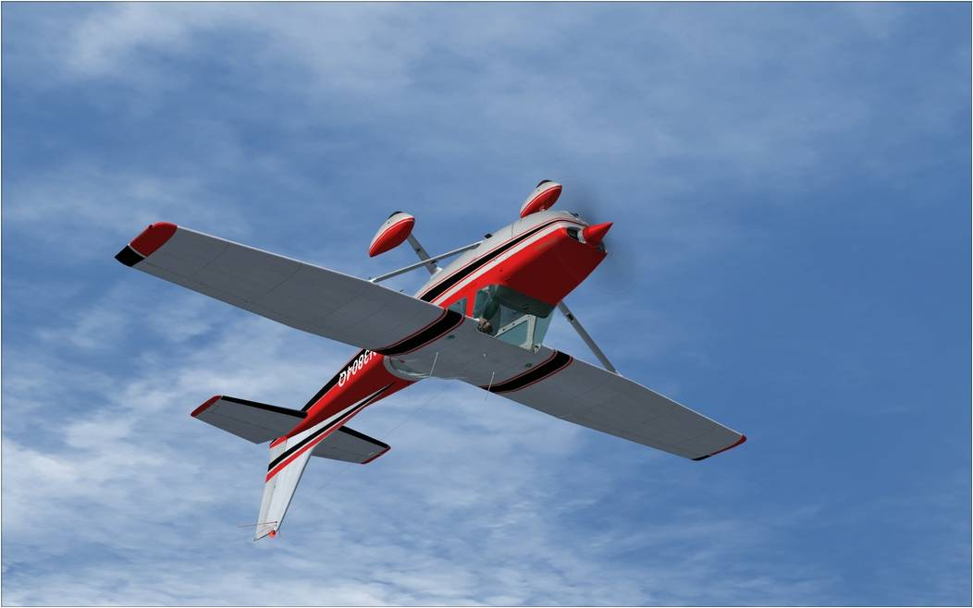
Flying Upside Down
Matthew 5:38-42 (NIV) ³⁸ "You have heard that it was said, 'Eye for eye, and tooth for tooth.' ³⁹ But I tell you, Do not resist an evil person. If someone strikes you on the right cheek, turn to him the other also. ⁴⁰ And if someone wants to sue you and take your tunic, let him have your cloak as well. ⁴¹ If someone forces you to go one mile, go with him two miles. ⁴² Give to the one who asks you, and do not turn away from the one who wants to borrow from you.

Slide 3
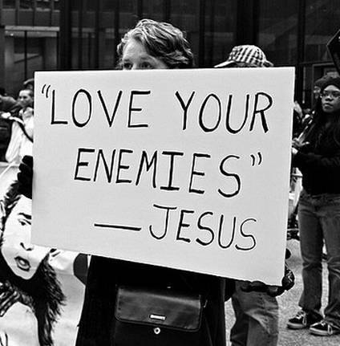
Who Are You Serving?
Romans 12:19-20 (NIV) ¹⁹ Do not take revenge, my friends, but leave room for God's wrath, for it is written: "It is mine to avenge; I will repay," says the Lord. ²⁰ On the contrary: "If your enemy is hungry, feed him; if he is thirsty, give him something to drink.

Slide 4
Forgiveness: God and You

Slide 5
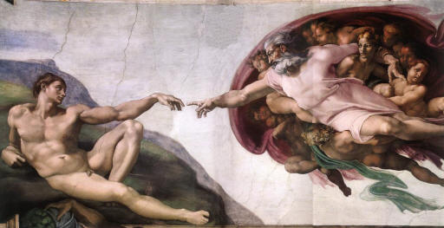
God So Loved The World
John 3:16-18 (NIV) ¹⁶ "For God so loved the world that he gave his one and only Son, that whoever believes in him shall not perish but have eternal life. ¹⁷ For God did not send his Son into the world to condemn the world, but to save the world through him. ¹⁸ Whoever believes in him is not condemned, but whoever does not believe stands condemned already because he has not believed in the name of God's one and only Son.
Romans 5:6-8 (NIV) ⁶ You see, at just the right time, when we were still powerless, Christ died for the ungodly. ⁷ Very rarely will anyone die for a righteous man, though for a good man someone might possibly dare to die. ⁸ But God demonstrates his own love for us in this: While we were still sinners, Christ died for us.

Slide 6
God So Loved The World
Romans 8:32 (NIV) ³² He who did not spare his own Son, but gave him up for us all--how will he not also, along with him, graciously give us all things?
The love of God is unlike anything else – it doesn’t make sense but it is true!

Slide 7
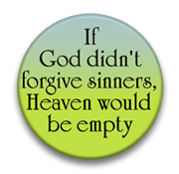
1 John
1 John 1:9 (NIV) ⁹ If we confess our sins, he is faithful and just and will forgive us our sins and purify us from all unrighteousness.
If we confess, he forgives

Slide 8
Psalms 103
Psalm 103:11-14 (NIV) ¹¹ For as high as the heavens are above the earth, so great is his love for those who fear him; ¹² as far as the east is from the west, so far has he removed our transgressions from us. ¹³ As a father has compassion on his children, so the LORD has compassion on those who fear him; ¹⁴ for he knows how we are formed, he remembers that we are dust.

Slide 9
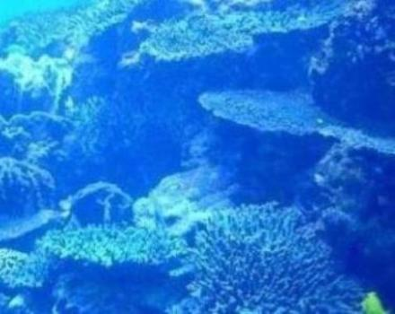
Micah 7
Micah 7:18-19 (NIV) ¹⁸ Who is a God like you, who pardons sin and forgives the transgression of the remnant of his inheritance? You do not stay angry forever but delight to show mercy. ¹⁹ You will again have compassion on us; you will tread our sins underfoot and hurl all our iniquities into the depths of the sea.

Slide 10
Prodigal Son
Luke 15:11-24 (NIV) ¹¹ Jesus continued: "There was a man who had two sons. ¹² The younger one said to his father, 'Father, give me my share of the estate.' So he divided his property between them. ¹³ "Not long after that, the younger son got together all he had, set off for a distant country and there squandered his wealth in wild living. ¹⁴ After he had spent everything, there was a severe famine in that whole country, and he began to be in need. ¹⁵ So he went and hired himself out to a citizen of that country, who sent him to his fields to feed pigs. ¹⁶ He longed to fill his stomach with the pods that the pigs were eating, but no one gave him anything. ¹⁷ "When he came to his senses, he said, 'How many of my father's hired men have food to spare, and here I am starving to death! ¹⁸ I will set out and go back to my father and say to him: Father, I have sinned against heaven and against you. ¹⁹ I am no longer worthy to be called your son; make me like one of your hired men.' ²⁰ So he got up and went to his father. "But while he was still a long way off, his father saw him and was filled with compassion for him; he ran to his son, threw his arms around him and kissed him. ²¹ "The son said to him, 'Father, I have sinned against heaven and against you. I am no longer worthy to be called your son.' ²² "But the father said to his servants, 'Quick! Bring the best robe and put it on him. Put a ring on his finger and sandals on his feet. ²³ Bring the fattened calf and kill it. Let's have a feast and celebrate. ²⁴ For this son of mine was dead and is alive again; he was lost and is found.' So they began to celebrate.

Slide 11
Prodigal Son
Doesn’t wait for his father to die but demands his inheritance now. Great inconvenience to his father to liquidate.
Basically says “I don’t care about you.”
Takes the money and goes far away
Wastes it on “wild living” – everything that goes against the values of the father
When money runs out and famine, realizes his father’s servants are better off than him
This is like me! How about you?
Comes back home
While he is far away and before he can say anything to his father, his father runs to him which is very undignified for a Jewish man
The father “kisses him much” and throws a big party for him
When we return, our father runs to us, kisses us much and celebrates.

Slide 12
Jesus on the Cross
Luke 23:34a (NIV) ³⁴ Jesus said, "Father, forgive them, for they do not know what they are doing.”
They didn’t ask for his forgiveness
Have you done worse things than crucifying Jesus?
If Jesus forgave them, any question whether He can forgive you?

Slide 13
Peter
Matthew 26:31-35 (NIV) ³¹ Then Jesus told them, "This very night you will all fall away on account of me, for it is written: "'I will strike the shepherd, and the sheep of the flock will be scattered.' ³² But after I have risen, I will go ahead of you into Galilee." ³³ Peter replied, "Even if all fall away on account of you, I never will." ³⁴ "I tell you the truth," Jesus answered, "this very night, before the rooster crows, you will disown me three times." ³⁵ But Peter declared, "Even if I have to die with you, I will never disown you." And all the other disciples said the same.
Mark 16:6-7 (NIV) ⁶ "Don't be alarmed," he said. "You are looking for Jesus the Nazarene, who was crucified. He has risen! He is not here. See the place where they laid him. ⁷ But go, tell his disciples and Peter, 'He is going ahead of you into Galilee. There you will see him, just as he told you.'"

Slide 14
Jeremiah 31
Jeremiah 31:34b (NIV) ³⁴ "For I will forgive their wickedness and will remember their sins no more."
He forgets our sins!

Slide 15
Quick Story

Slide 16
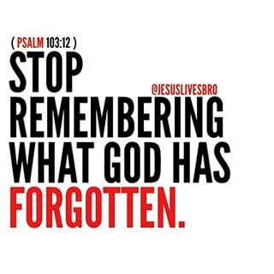
You Are Forgiven!

Slide 17
Summary
God knows we will fail Him and He loves us and draws us back to Himself. We don’t surprise God by our failures.
He delights to show mercy!
He forgets our sins!
He runs to us and kisses us much!
We may not feel this and we often may feel the opposite but we must believe and act on and grow toward the fact that we are truly forgiven.
Romans 8:1 (NIV) ¹ Therefore, there is now no condemnation for those who are in Christ Jesus,

Slide 18
Forgiveness: You and You

Slide 19
Simple?
Understand that God has forgiven you
If God has forgiven you, you can forgive yourself. How can you not forgive yourself if God has forgiven you?
This is NOT easy for many. This is a process that takes much time with God’s help.
It is TRUTH that must be sought with great effort. Satan uses false guilt to keep us from being who God wants us to be.

Slide 20
Trust
Our response to the love of Jesus demands trust. Do we rely on our resume or the gospel of grace? How do we cope with failure?
Grace tells us that we are accepted just as we are. We may not be the kind of people we want to be, we may be a long way from our goals, we may have more failures than achievements, we may have done horrible things, we may not be wealthy or powerful or spiritual, we may not even be happy, but we are nonetheless accepted by God, held in his hands.
Such is his promise to us in Jesus Christ, a promise we can trust. For those who feel their lives are a grave disappointment to God, it requires enormous trust and reckless, raging confidence to accept that the love of Christ knows no shadow of alteration or change.
From Brennan Manning’s book called The Ragamuffin Gospel

Slide 21
Fact
There is nothing we can do to make God love us any more or any less.
Quote from Tim Keller, Pastor in NYC

Slide 22
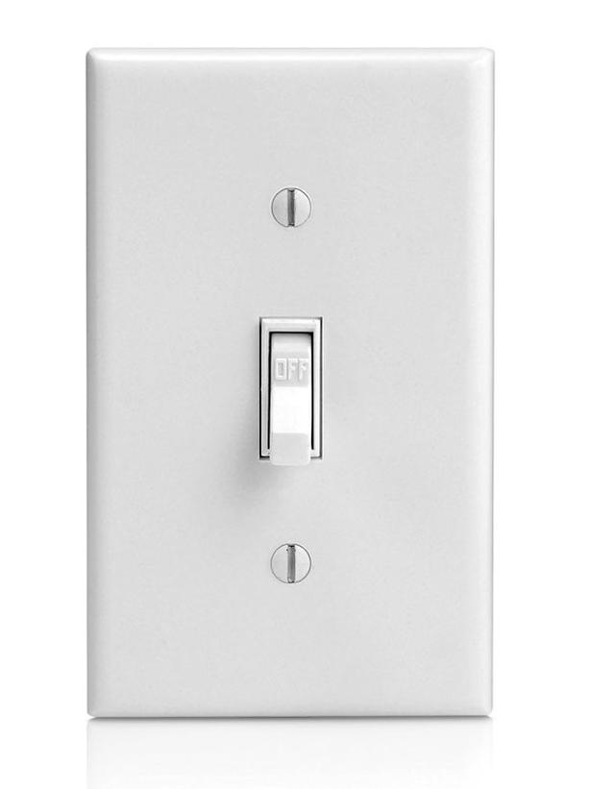
Just Flip A Switch!

Slide 23
Forgiveness: You and Others

Slide 24
Colossians
Colossians 3:13 (NIV) ¹³ Bear with each other and forgive whatever grievances you may have against one another. Forgive as the Lord forgave you.
We must be fully aware and very grateful of God’s forgiveness to us and then it will be less difficult to forgive others.
With all we have done, how amazing is it that God has forgiven us? How can we NOT forgive others?

Slide 25
Matthew 18
Matthew 18:21-22 (NIV) ²¹ Then Peter came to Jesus and asked, "Lord, how many times shall I forgive my brother when he sins against me? Up to seven times?" ²² Jesus answered, "I tell you, not seven times, but seventy-seven times.
Not 77 times but limitless!
How many times do we want or need God to forgive us?
How hard is this but how good is this?

Slide 26
Parable 10,000 Talents
Matthew 18:23-35 (NIV) ²³ "Therefore, the kingdom of heaven is like a king who wanted to settle accounts with his servants. ²⁴ As he began the settlement, a man who owed him ten thousand talents was brought to him. ²⁵ Since he was not able to pay, the master ordered that he and his wife and his children and all that he had be sold to repay the debt. ²⁶ "The servant fell on his knees before him. 'Be patient with me,' he begged, 'and I will pay back everything.' ²⁷ The servant's master took pity on him, canceled the debt and let him go. ²⁸ "But when that servant went out, he found one of his fellow servants who owed him a hundred denarii. He grabbed him and began to choke him. 'Pay back what you owe me!' he demanded. ²⁹ "His fellow servant fell to his knees and begged him, 'Be patient with me, and I will pay you back.' ³⁰ "But he refused. Instead, he went off and had the man thrown into prison until he could pay the debt. ³¹ When the other servants saw what had happened, they were greatly distressed and went and told their master everything that had happened. ³² "Then the master called the servant in. 'You wicked servant,' he said, 'I canceled all that debt of yours because you begged me to. ³³ Shouldn't you have had mercy on your fellow servant just as I had on you?' ³⁴ In anger his master turned him over to the jailers to be tortured, until he should pay back all he owed. ³⁵ "This is how my heavenly Father will treat each of you unless you forgive your brother from your heart."
10,000 talents would take 160,000-200,000 years to pay back. You could never pay that back and neither could we ever pay back what we have been forgiven of by God.
“Forgive others as Christ has forgiven you!”

Slide 27
Why Would God Do This?
He loves us so much. He died for us.
He hates sin because it separates us from Him here on earth and for eternity.
Forgiveness restores the broken relationship and reminds us of God’s love.
We can then trust him, surrender our lives to Him, serve Him and give Him glory.
Why are we fighting Him?

Slide 28
Slaves of Christ
Love
Peace
Joy
Fellowship
Faith
Humility
Sacrifice
Compassion
Sharing
Faithfulness
True Friendship
Hope
Wisdom
Kindness
Gentleness
Truthfulness
Strong Relationships
Riches (not $$$)
Eternity in Heaven
Others?

Slide 29
Slaves to Self and Sin
Drugs
Alcohol
Sexual Diseases
Anger
Hate
Worry
Revenge
Theft
Dishonesty
Using People .
Jail/Prison
Divorce
Restitution
Welfare
Broken Relationships
Guilt
Poor Health
Money Issues
Eternity in Hell
Others? .

Slide 30
Repent (Turn) and Believe

Slide 31
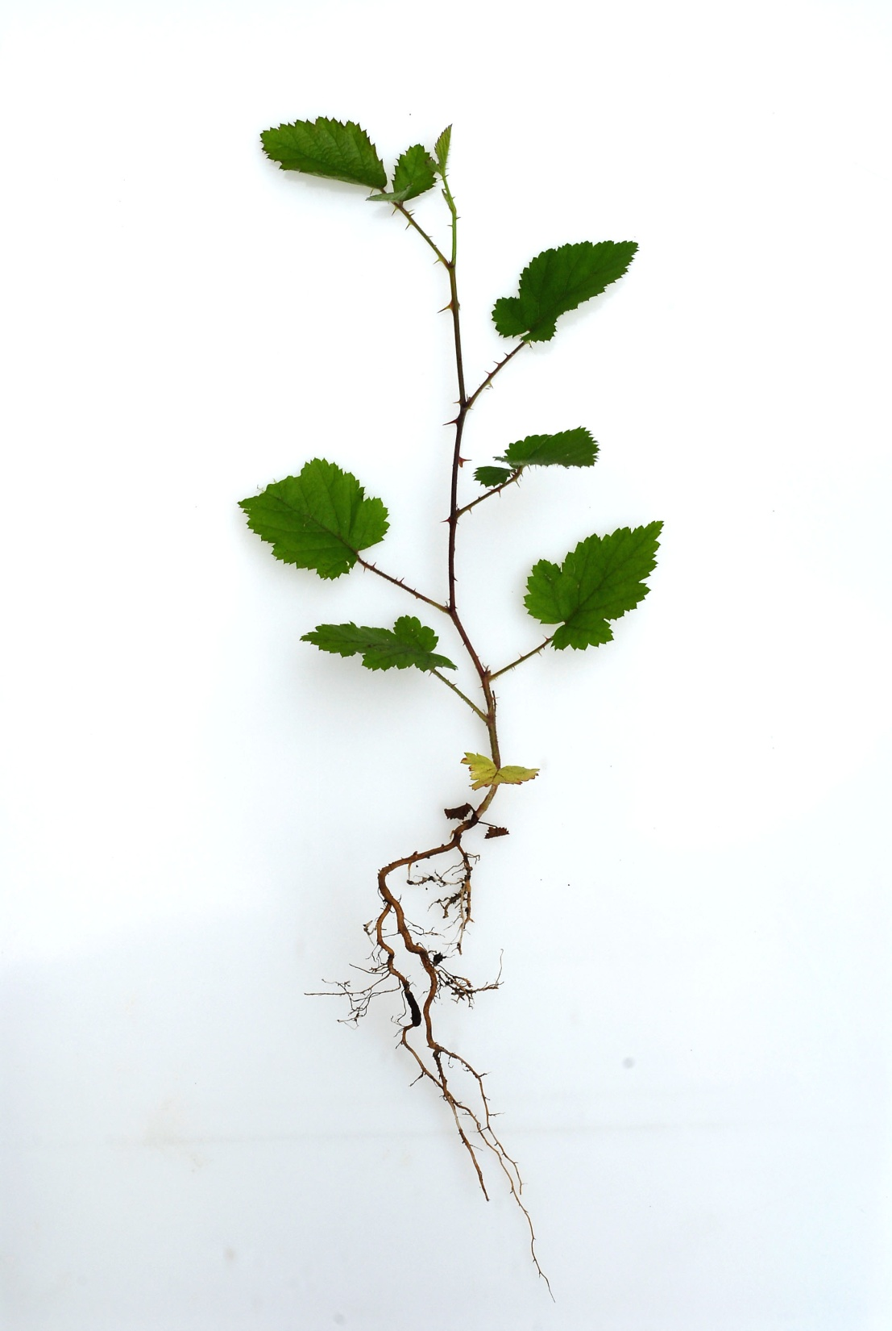

Slide 32
Study Ideas…
Matthew 18:3 (NIV) ³ And he said: "I tell you the truth, unless you change and become like little children, you will never enter the kingdom of heaven.
Matthew 6:19-20 (NIV) ¹⁹ "Do not store up for yourselves treasures on earth, where moth and rust destroy, and where thieves break in and steal. ²⁰ But store up for yourselves treasures in heaven, where moth and rust do not destroy, and where thieves do not break in and steal.
Philippians 4:6 (NIV) ⁶ Do not be anxious about anything, but in everything, by prayer and petition, with thanksgiving, present your requests to God.
Hebrews 12:5-7 (NIV) ⁵ And you have forgotten that word of encouragement that addresses you as sons: "My son, do not make light of the Lord's discipline, and do not lose heart when he rebukes you, ⁶ because the Lord disciplines those he loves, and he punishes everyone he accepts as a son." ⁷ Endure hardship as discipline; God is treating you as sons. For what son is not disciplined by his father?
James 1:2 (NIV) ² Consider it pure joy, my brothers, whenever you face trials of many kinds,

Slide 33
Questions/Comments?

